Slide 1
Module 10: Zone-Based Policy Firewalls
Networking Security v1.0
(NETSEC)
Notes:
Networking Security (NETSEC) Module 10: Zone-Based Policy Firewalls

Slide 2
Module Objectives
Module Title: Zone-Based Policy Firewalls
Module Objective: Implement Zone-Based Policy Firewall using CLI.
Topic Title | Topic Objective
ZPF Overview | Explain how Zone-Based Firewalls are used to help secure a network.
ZPF Operation | Explain the operation of a Zone-Based Policy Firewall.
Configuring a ZPF | Configure a Zone-Based Firewall with CLI.
Notes:
2
1 – Networking Today
1.0.2 – What will I learn to do in this module?

Slide 3
10.1 ZPF Overview
Notes:
10: Zone-Based Policy Firewalls 10.1: ZPF Overview

Slide 4
ZPF Overview
Benefits of a ZPF
There are two configuration models for Cisco IOS Firewall:
Classic Firewall - The traditional configuration model in which firewall policy is applied on interfaces.
Zone-based Policy Firewall (ZPF) - The new configuration mode in which interfaces are assigned to security zones, and firewall policy is applied to traffic moving between the zones.
There are several benefits of a ZPF:
It is not dependent on ACLs.
The router security posture is to block unless explicitly allowed.
Policies are easy to read and troubleshoot with the Cisco Common Classification Policy Language (C3PL). C3PL is a structured method to create traffic policies based on events, conditions, and actions. This provides scalability because one policy affects any given traffic, instead of needing multiple ACLs and inspection actions for different types of traffic.
Virtual and physical interfaces can be grouped into zones.
Policies are applied to unidirectional traffic between zones.
Notes:
10: Zone-Based Policy Firewalls 10.1: ZPF Overview 10.1.1: Benefits of a ZPF

Slide 5
ZPF Overview
ZPF Design
Designing ZPFs involves several steps:
Step 1. Determine the zones. A zone defines a boundary where traffic is subjected to policy restrictions as it crosses to another region of the network.
Step 2. Establish policies between zones. Define the sessions that clients in the source zones can request from servers in destination zones.
Step 3. Design the physical infrastructure. This includes dictating the number of devices between most-secure and least-secure zones and determining redundant devices.
Step 4. Identify subsets within zones and merge traffic requirements. Although an important consideration, implementing zone subsets is beyond the scope of this curriculum.
Notes:
10: Zone-Based Policy Firewalls 10.1: ZPF Overview 10.1.2: ZPF Design

Slide 6
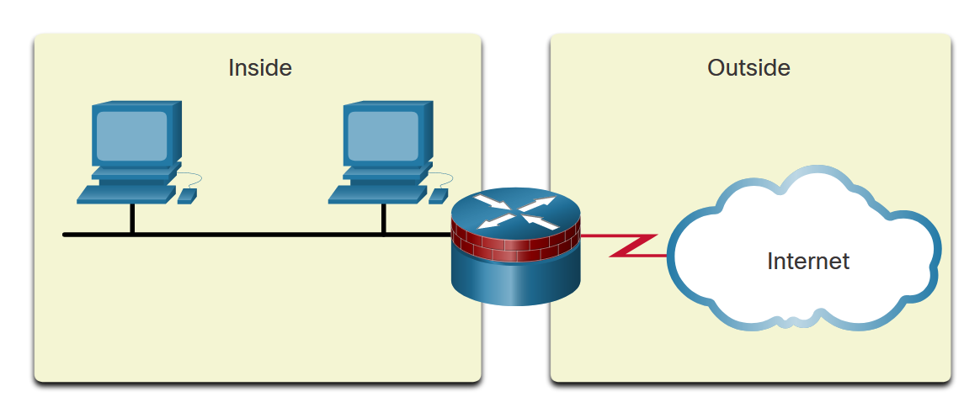
ZPF Overview
ZPF Design (Cont.)
LAN to Internet Example
Notes:
10: Zone-Based Policy Firewalls 10.1: ZPF Overview 10.1.2: ZPF Design

Slide 7
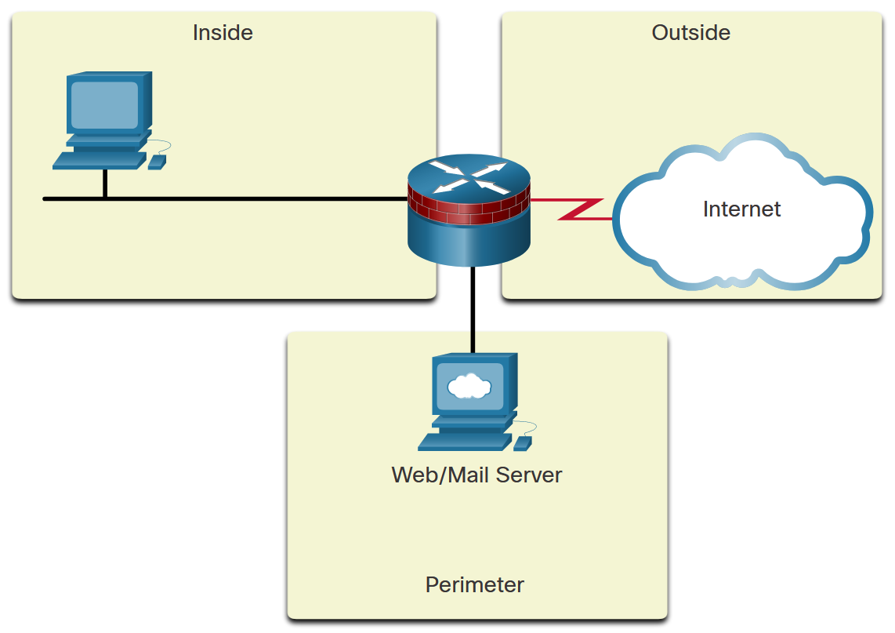
ZPF Overview
ZPF Design (Cont.)
Firewall with Public Servers Example 1
Notes:
10: Zone-Based Policy Firewalls 10.1: ZPF Overview 10.1.2: ZPF Design

Slide 8
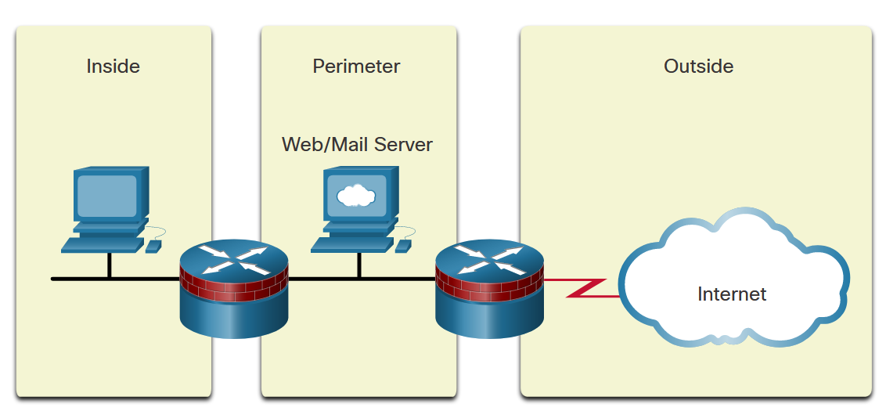
ZPF Overview
ZPF Design (Cont.)
Firewall with Public Servers Example 2
Notes:
10: Zone-Based Policy Firewalls 10.1: ZPF Overview 10.1.2: ZPF Design

Slide 9
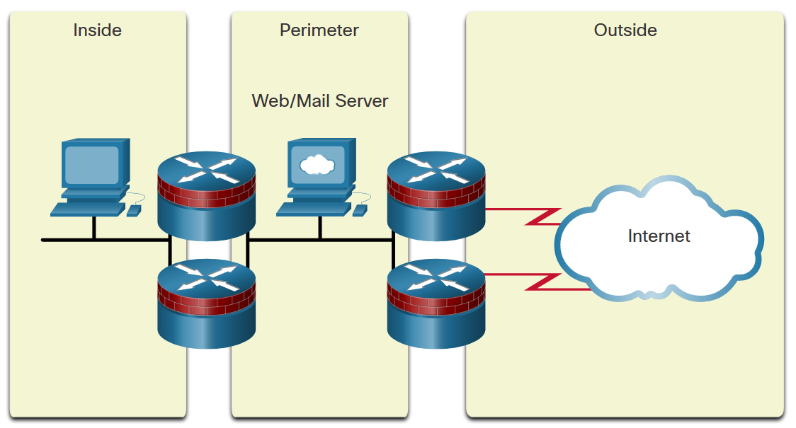
ZPF Overview
ZPF Design (Cont.)
Redundant Firewalls
Notes:
10: Zone-Based Policy Firewalls 10.1: ZPF Overview 10.1.2: ZPF Design

Slide 10
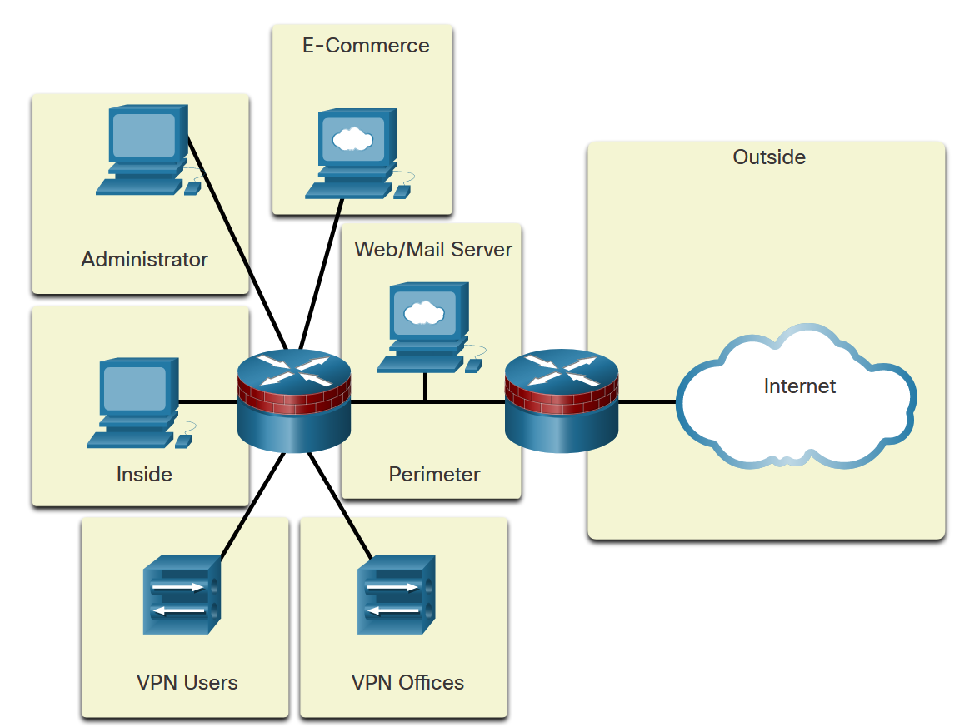
ZPF Overview
ZPF Design (Cont.)
Complex Firewall
Notes:
10: Zone-Based Policy Firewalls 10.1: ZPF Overview 10.1.2: ZPF Design

Slide 11
10.2 ZPF Operation
Notes:
10: Zone-Based Policy Firewalls 10.2: ZPF Operation

Slide 12
ZPF Operation
ZPF Actions
Policies identify actions that the ZPF will perform on network traffic. Three possible actions can be configured to process traffic by protocol, source and destination zones (zone pairs), and other criteria.
Inspect - Performs Cisco IOS stateful packet inspection.
Drop - Analogous to a deny statement in an ACL. A log option is available to log the rejected packets.
Pass - Analogous to a permit statement in an ACL. The pass action does not track the state of connections or sessions within the traffic.
Notes:
10: Zone-Based Policy Firewalls 10.2: ZPF Operation 10.2.1: ZPF Actions

Slide 13
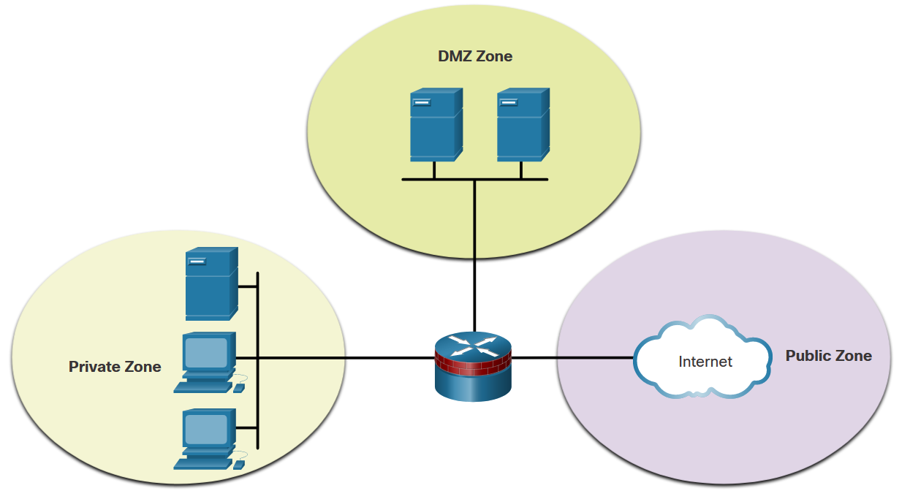
ZPF Operation
Rules for Transit Traffic
Traffic transiting through router interfaces is subject to several rules governing interface behavior. For the transit traffic example, refer to the topology shown in the figure.
Source Interface Member of Zone? | Destination Interface Member of Zone? | Zone-Pair Exists? | Policy Exists? | Result
NO | NO | N/A | N/A | PASS
YES | NO | N/A | N/A | DROP
NO | YES | N/A | N/A | DROP
YES (private) | YES (private) | N/A | N/A | PASS
YES (private) | YES (public) | NO | N/A | DROP
YES (private) | YES (public) | YES | NO | PASS
YES (private) | YES (public) | YES | YES | INSPECT
Notes:
10: Zone-Based Policy Firewalls 10.2: ZPF Operation 10.2.2: Rules for Transit Traffic

Slide 14
ZPF Operation
Rules for Traffic to the Self Zone
The self zone is the router itself and includes all the IP addresses assigned to the router interfaces. This is traffic that originates at the router or is addressed to a router interface.
The rules depend on whether the router is the source or the destination of the traffic, as shown in the table.
Source Interface Member of Zone? | Destination Interface Member of Zone? | Zone-Pair Exists? | Policy Exists? | Result
YES (self zone) | YES | NO | N/A | PASS
YES (self zone) | YES | YES | NO | PASS
YES (self zone) | YES | YES | YES | INSPECT
YES | YES (self zone) | NO | N/A | PASS
YES | YES (self zone) | YES | NO | PASS
YES | YES (self zone) | YES | YES | INSPECT
Notes:
10: Zone-Based Policy Firewalls 10.2: ZPF Operation 10.2.3: Rules for Traffic to the Self Zone
10.2.4: Check Your Understanding - Rules for Transit Traffic

Slide 15
10.3 Configure a ZPF
Notes:
10: Zone-Based Policy Firewalls 10.3: Configure a ZPF

Slide 16
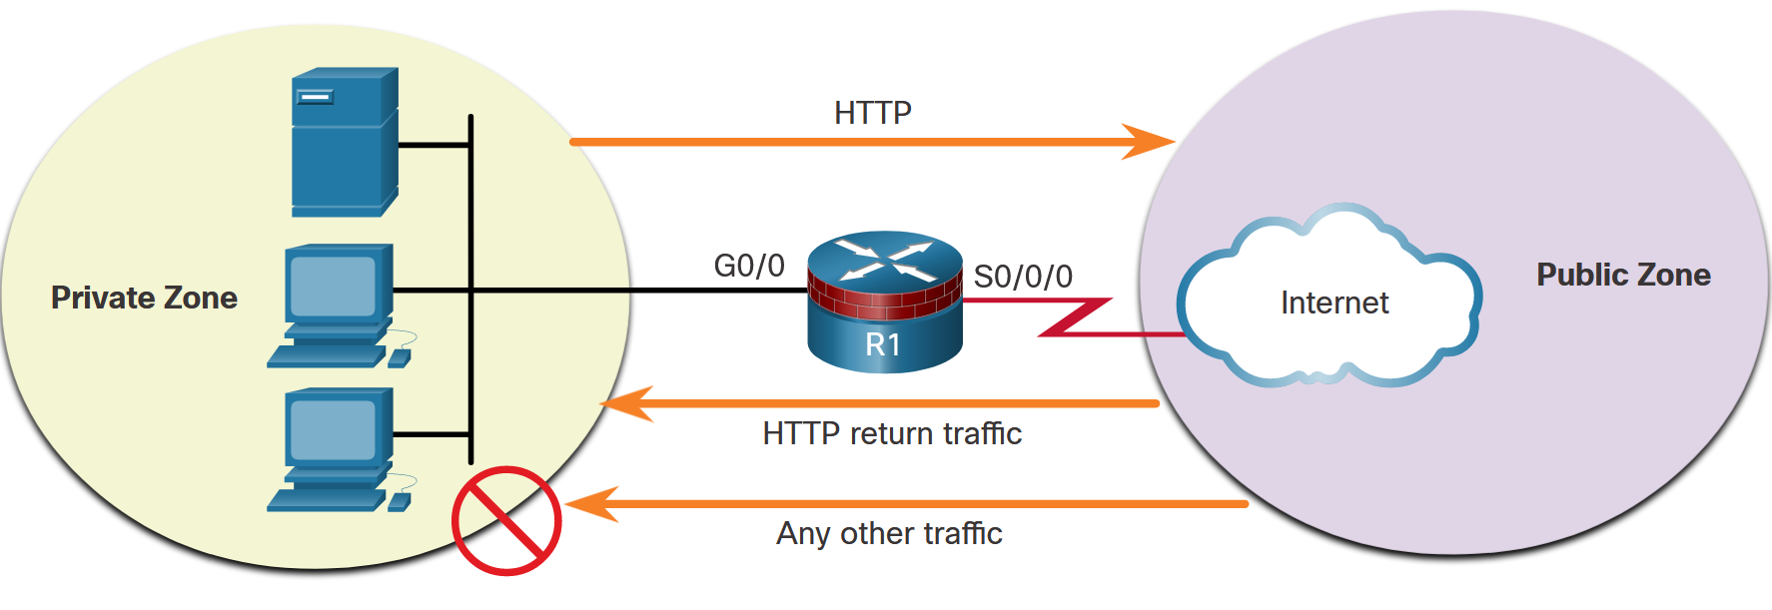
Configure a ZPF
Configure a ZPF
The topology and steps shown in the figure will be used throughout the remainder of this topic to demonstrate ZPF configuration.
Step 1: Create the zones.
Step 2: Identify traffic with a class-map.
Step 3: Define an action with a policy-map.
Step 4: Identify a zone pair and match it to a policy-map.
Step 5: Assign zones to the appropriate interfaces.
Notes:
10: Zone-Based Policy Firewalls 10.3: Configure a ZPF 10.3.1: Configure a ZPF

Slide 17
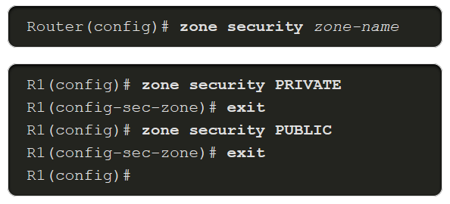
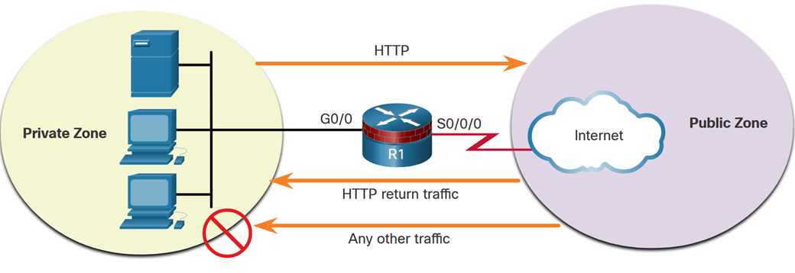
Configure a ZPF
Step 1. Create Zones
The first step, is to create the zones. However, before creating the zones answer a few questions:
What interfaces should be included in the zones?
What will be the name for each zone?
What traffic is necessary between the zones and in which direction?
In the example topology, we have two interfaces, two zones, and traffic flowing in one direction. Traffic sourced from the public zone will not be allowed. Create the private and public zones for the firewall with the zone security command, as shown here.
Notes:
10: Zone-Based Policy Firewalls 10.3: Configure a ZPF 10.3.2: Step 1. Create Zones

Slide 18
Configure a ZPF
Step 2. Identify Traffic
The second step is to use a class-map to identify the traffic to which a policy will be applied.
The figure shows the syntax for the class-map command. There are several types of class-maps. For a ZPF configuration, use the inspect keyword to define a class-map. Determine how packets are evaluated when multiple match criteria exist. Packets must meet one of the match criteria (match-any) or all of the match criteria (match-all) to be considered a member of the class.
Parameter | Description
match-any | Packets must meet one of the match criteria to be considered a member of the class.
match-all | Packets must meet all of the match criteria to be considered a member of the class.
class-map-name | Name of the class-map that will be used to configure the policy for the class in the policy-map.
Notes:
10: Zone-Based Policy Firewalls 10.3: Configure a ZPF 10.3.3: Step 2. Identify Traffic

Slide 19

Configure a ZPF
Step 2. Identify Traffic (Cont.)
The figure shows the syntax for the match statements in class-map sub-configuration mode. Match traffic to an ACL, a specific protocol, or even another class-map.
Parameter | Description
match access-group | Configures the match criteria for a class-map based on the specified ACL number or name.
match protocol | Configures the match criteria for a class-map based on the specified protocol.
match class-map | Uses another class-map to identify traffic.
Notes:
10: Zone-Based Policy Firewalls 10.3: Configure a ZPF 10.3.3: Step 2. Identify Traffic

Slide 20

Configure a ZPF
Step 3. Define an Action
The third step is to use a policy-map to define what action should be taken for traffic that is a member of a class. The figure shows the command syntax to configure a policy-map. An action is a specific functionality. It is typically associated with a traffic class. For example, inspect, drop, and pass are actions.
Parameter | Description
inspect | An action that offers state−based traffic control. The router maintains session information for TCP and UDP and permits return traffic.
drop | Discards unwanted traffic
pass | A stateless action that allows the router to forward traffic from one zone to another
Notes:
10: Zone-Based Policy Firewalls 10.3: Configure a ZPF 10.3.4: Step 3. Define an Action

Slide 21
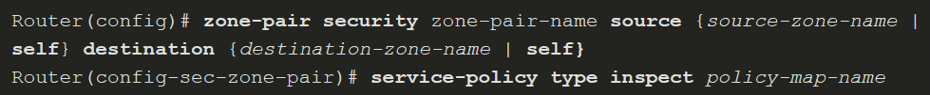
Configure a ZPF
Step 4. Identify a Zone-Pair and Match to a Policy
The fourth step is to identify a zone pair and associate that zone pair to a policy-map. The figure shows the command syntax. Create a zone-pair with the zone-pair security command. Then use the service-policy type inspect command to attach a policy-map and its associated action to the zone-pair.
Parameter | Description
source source-zone-name | Specifies the name of the zone from which traffic is originating.
destination destination-zone-name | Specifies the name of the zone to which traffic is destined.
self | Specifies the system-defined zone. Indicates whether traffic will be going to or from the router itself.
Notes:
10: Zone-Based Policy Firewalls 10.3: Configure a ZPF 10.3.5: Step 4. Identify a Zone-Pair and Match to a Policy

Slide 22

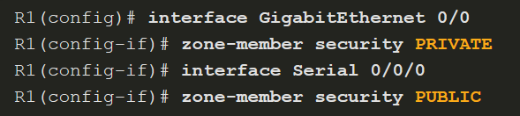
Configure a ZPF
Step 5. Assign Zones to Interfaces
The fifth step is to assign zones to the appropriate interfaces. Associating a zone to an interface will immediately apply the service-policy that has been associated with the zone. If no service-policy is yet configured for the zone, all transit traffic will be dropped. Use the zone-member security command to assign a zone to an interface. In the example, GigabitEthernet 0/0 is assigned the PRIVATE zone, and Serial 0/0/0 is assigned the PUBLIC zone.
In the following example, GigabitEthernet 0/0 is assigned the PRIVATE zone, and Serial 0/0/0 is assigned the PUBLIC zone.
Notes:
10: Zone-Based Policy Firewalls 10.3: Configure a ZPF 10.3.6: Step 5. Assign Zones to Interfaces

Slide 23
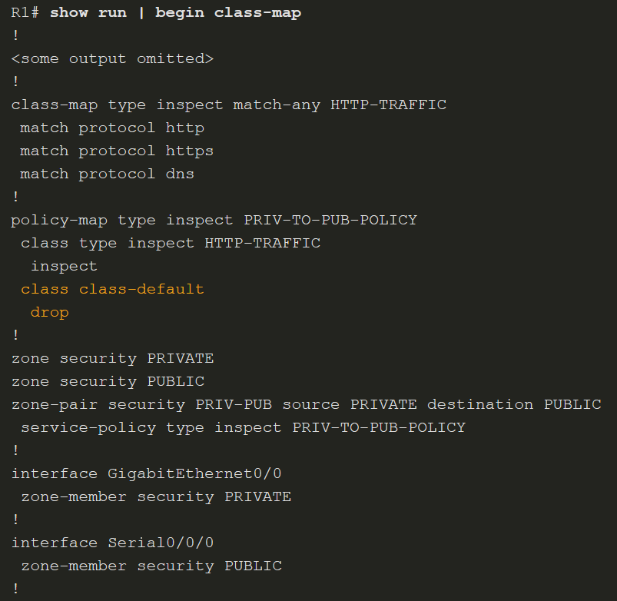
Configure a ZPF
Verify a ZPF Configuration
Verify a ZPF configuration by viewing the running configuration. Notice that the class-map is listed first. Then the policy-map makes use of the class-map.
The zone configurations follow the policy-map configurations with zone naming, zone pairing, and associating a service-policy to the zone pair.
Finally, the interfaces are assigned zones.
Notes:
10: Zone-Based Policy Firewalls 10.3: Configure a ZPF 10.3.7: Verify a ZPF Configuration

Slide 24
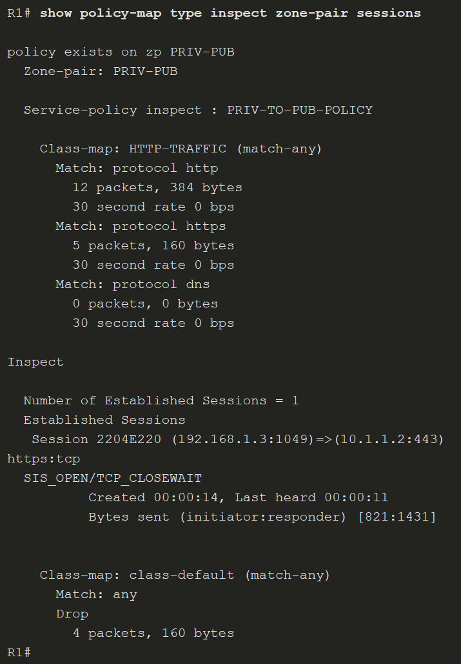
Configure a ZPF
Verify a ZPF Configuration (Cont.)
The example shows verification information after a test of the ZPF configuration. A PRIVATE zone host 192.168.1.3 established an HTTPS session with a web server at 10.1.1.2. Notice further down in the command output that four packets matched the class class-default. This verification information was generated by having host 192.168.1.3 ping the web server at 10.1.1.2.
Other commands include:
show class-map type inspect
show zone security
show zone-pair security
show policy-map type inspect
Notes:
10: Zone-Based Policy Firewalls 10.3: Configure a ZPF 10.3.7: Verify a ZPF Configuration
10.3.8: Syntax Checker-Configure a ZPF

Slide 25
Configure a ZPF
ZPF Configuration Considerations
When configuring a ZPF with the CLI, there are several factors to consider:
The router never filters the traffic between interfaces in the same zone.
An interface cannot belong to multiple zones. To create a union of security zones, specify a new zone and appropriate policy map and zone pairs.
ZPF can coexist with Classic Firewall although they cannot be used on the same interface. Remove the ip inspect interface configuration command before applying the zone-member security command.
Traffic can never flow between an interface assigned to a zone and an interface without a zone assignment. Applying the zone-member configuration command always results in a temporary interruption of service until the other zone-member is configured.
The default inter-zone policy is to drop all traffic unless otherwise specifically allowed by the service-policy configured for the zone-pair.
The zone-member command does not protect the router itself (traffic to and from the router is not affected) unless the zone- pairs are configured using the predefined self zone.
Notes:
10: Zone-Based Policy Firewalls 10.3: Configure a ZPF 10.3.9: ZPF Configuration Considerations

Slide 26
Configure a ZPF
Video Demonstration - ZPFs
This video is a demonstration of ZPFs.
Notes:
10: Zone-Based Policy Firewalls 10.3: Configure a ZPF 10.3.10: Video Demonstration - ZPFs

Slide 27
Configure a ZPF
Packet Tracer - Configure ZPF
In this Packet Tracer, you will complete the following objectives:
Verify connectivity among devices before firewall configuration.
Configure a ZPF on router R3.
Verify ZPF functionality using ping, Telnet, and a web browser.
Notes:
10: Zone-Based Policy Firewalls 10.3: Configure a ZPF 10.3.11: Packet Tracer - Configure ZPF

Slide 28
Configure a ZPF
Lab - Configure ZPFs
In this lab, you will complete the following objectives:
Complete a basic router configuration.
Use the CLI to configure a ZPF
Use the CLI to verify the configuration.
Notes:
10: Zone-Based Policy Firewalls 10.3: Configure a ZPF 10.3.12: Lab - Configure ZPF

